Slide 1
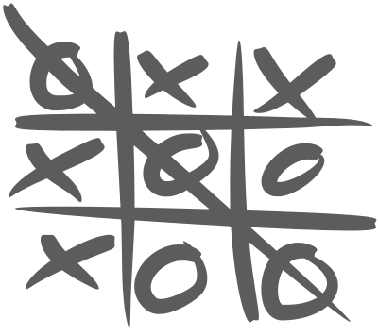
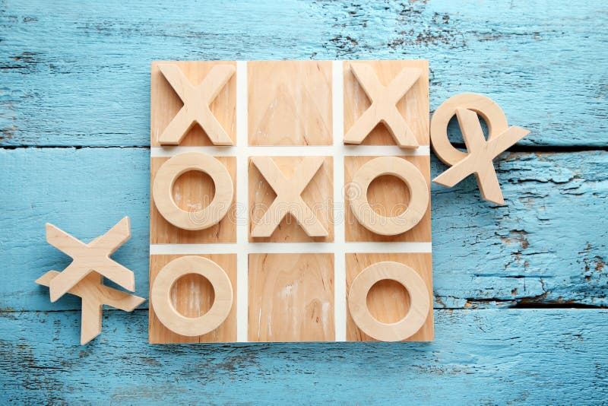
Tic Tac Toe Game
"Unleash your strategic prowess and dominate the grid in the classic game of Tic-Tac-Toe. Experience the timeless thrill, now reimagined in Python!”
By : Angela Brill & Mona Hanna
https://github.com/ksu-is/TicTacToe.-Project

